Slide 1
Comparing TV shows

Slide 2
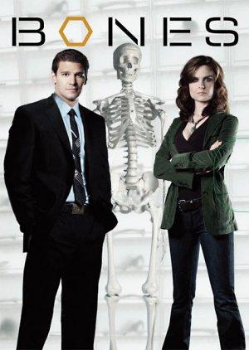

Bones is older than The Blacklist

Slide 3

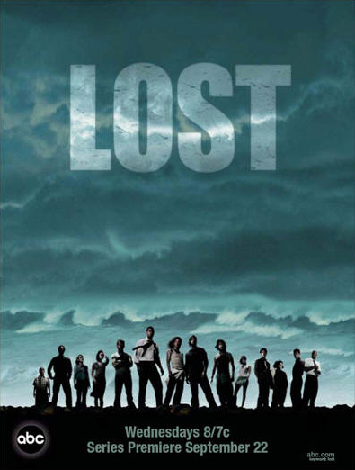
Orange is the new black is most popular than Lost

Slide 4

The walking dead is the best at the time

Slide 5
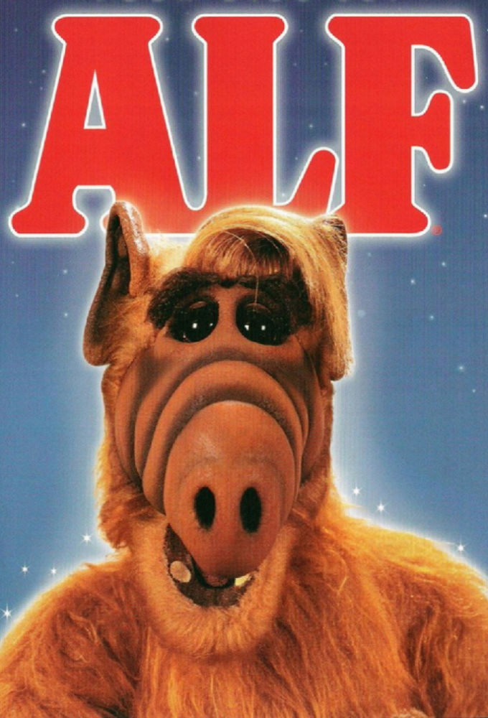
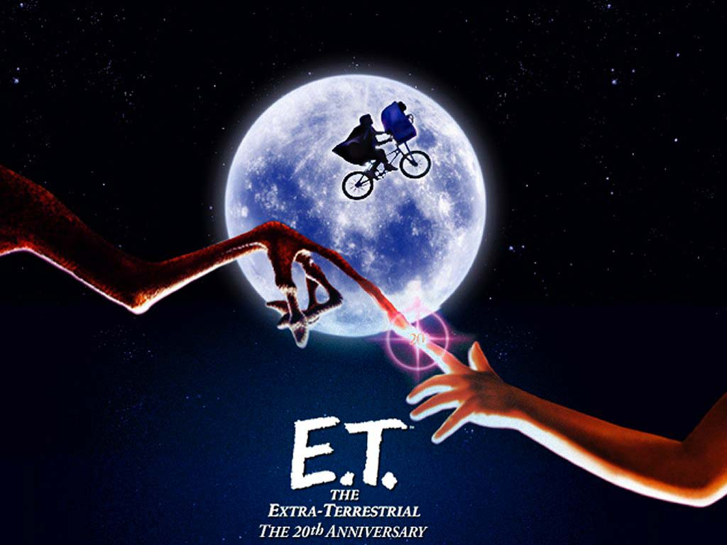
Alf is worst than E.T
V

